Slide 1

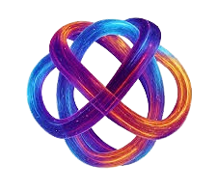
Smart Traffic Optimization
In the New Capital

Slide 2
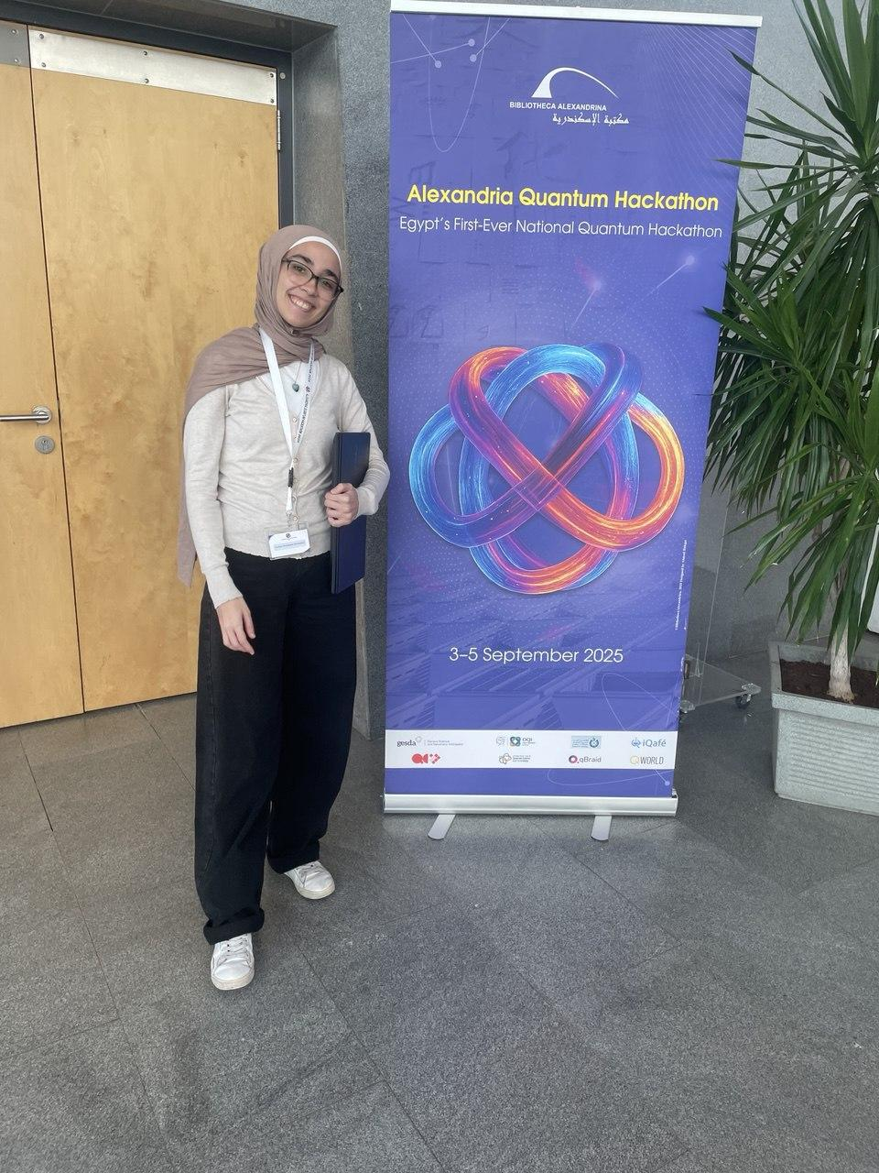


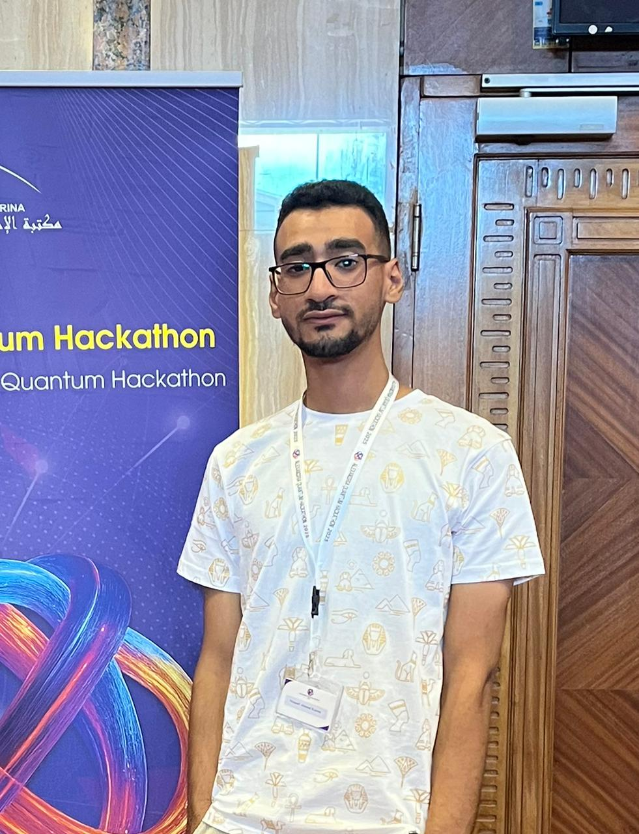
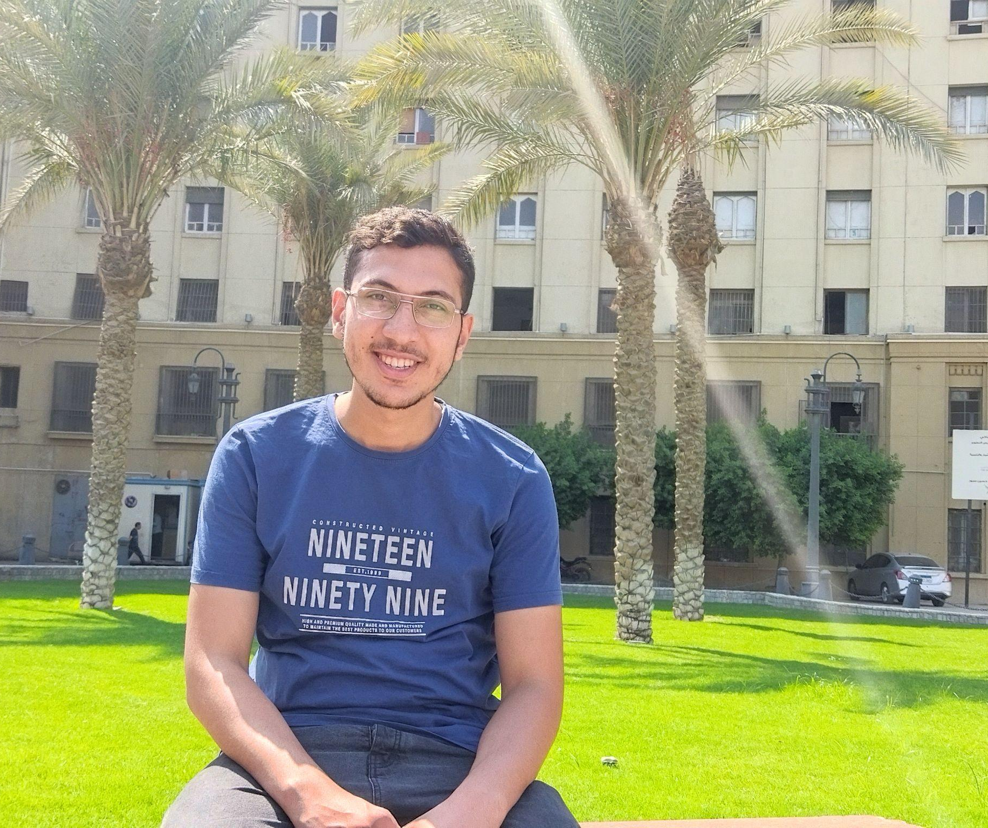
Team Members
Nadine Tamish
Shahd Tamer
Mahmoud ElShimi
Youssef Karem
Abdelrahman
Abohendy
Faculty of Engineering, Alexandria University
Faculty of Computer Science, EJUST
Graduated from Al-Azhar University
Faculty of Computer Science, Alexandria National University
Faculty of Engineering, Cairo University
Mentored by:
Gehad Salem and Jad Mchaimech

Slide 3
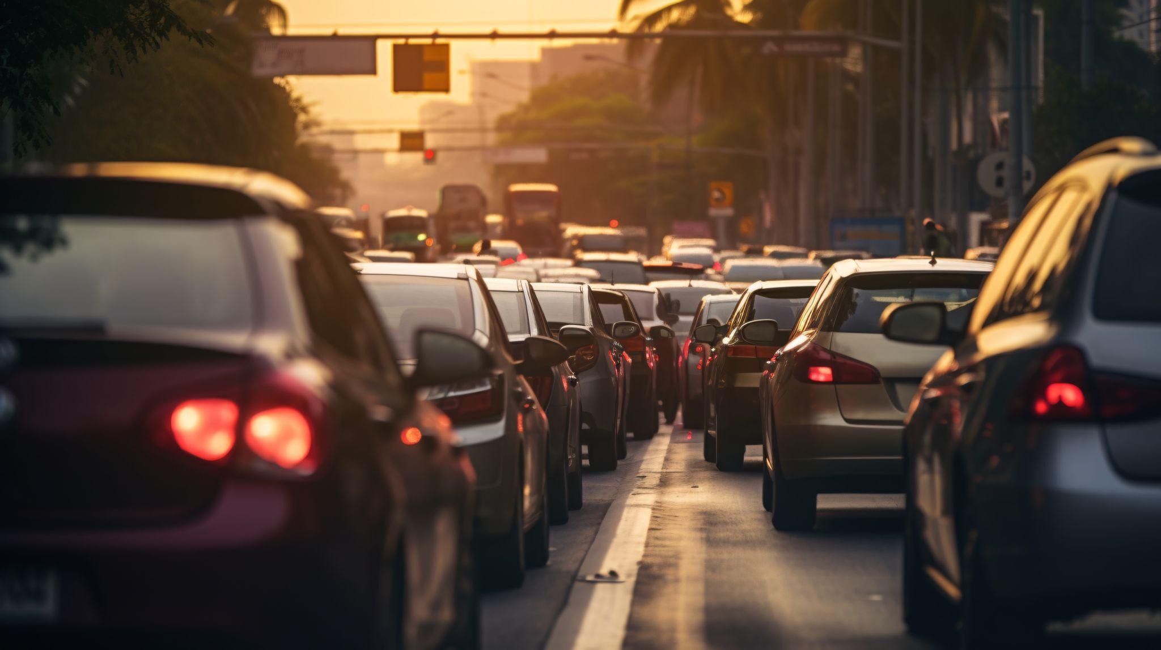
Story Time

Slide 4
Use Cases for Smart Traffic Optimization
Police & Security
Hospitals & Emergency Care
Firefighting & Civil Defense
Smart City Logistics
Metro & Public Transport
School & Public Services

Slide 5
Table of contents
01
02
03
04
Problem Definition
Classical Approach
You can describe the topic of the section here
You can describe the topic of the section here
Quantum Approach
Comparison
You can describe the topic of the section here
You can describe the topic of the section here

Slide 6

01
Problem Definition
By: Abdelrahman Abohendy

Slide 7
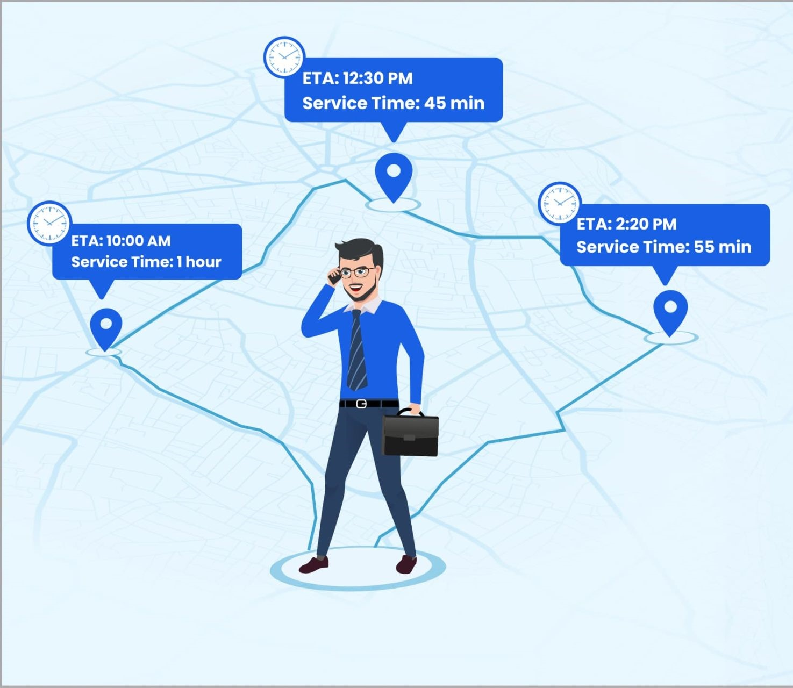
Introduction
A variation of the classical Vehicle Routing Problem (VRP) or Travelling Salesman Problem.
Set of nodes need to be visited only once by the travelling salesman and in order to reduce cost, effort and time, they should take the shortest path.

Slide 8
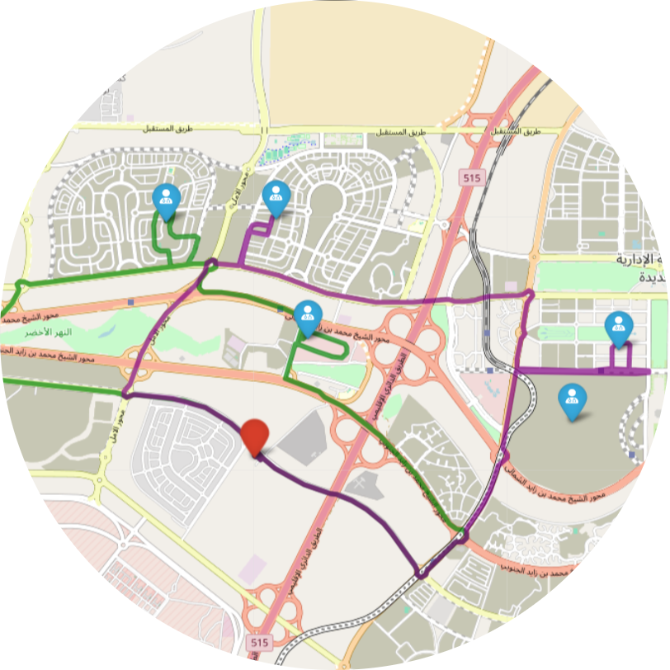
Scenario
One Hospital, an ambulance and 5 patients
Max 3 patients per trip ( so , it is Capacitated Vehicle Routing Problem)
Multiple trips allowed

Slide 9
Formulation and Pre-processing

Slide 10
Haversine
vs
OSRM
A mathematical formula to calculate the shortest distance between two points on a sphere using their latitude and longitude.
Approximates Earth as a perfect sphere → does not consider roads or obstacles.
Provides straight-line distance.
Ignores road networks, traffic, and real routes.
A high-performance routing engine built on OpenStreetMap data, used to compute real-world road distances and routes.
Considers actual road networks, intersections, one-way streets, and driving constraints.
Produces real-world road distances and estimated durations.
Can optimize routes for multiple patients or locations.

Slide 11
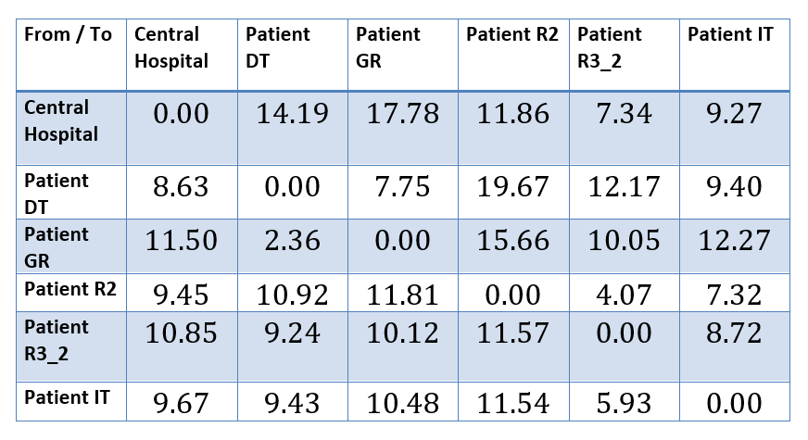
Distance Calculation

Slide 12
02
Classical Approach
By: Shahd Tamer and Nadine Tamish

Slide 13
Solution
So, we are going to get the shortest path to get all 5 patients.
Classical Approach
Quantum Approach

Slide 14
Worst-case Approach

Slide 15
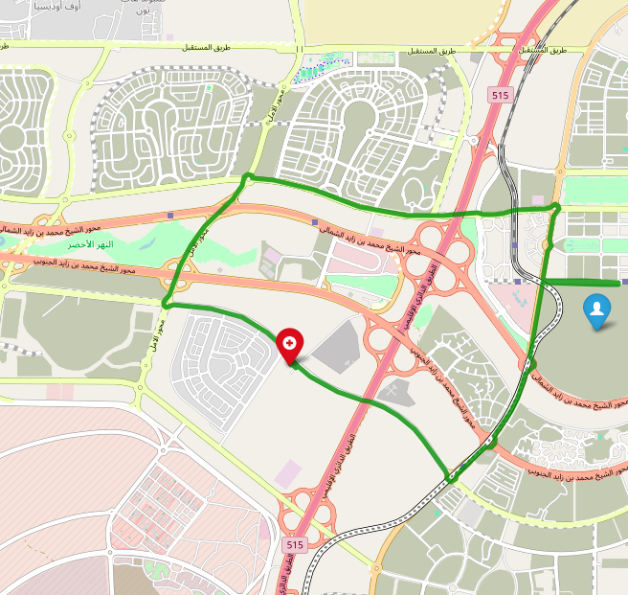
From Hospital to Patient DT
Total Distance=22.82 KM

Slide 16
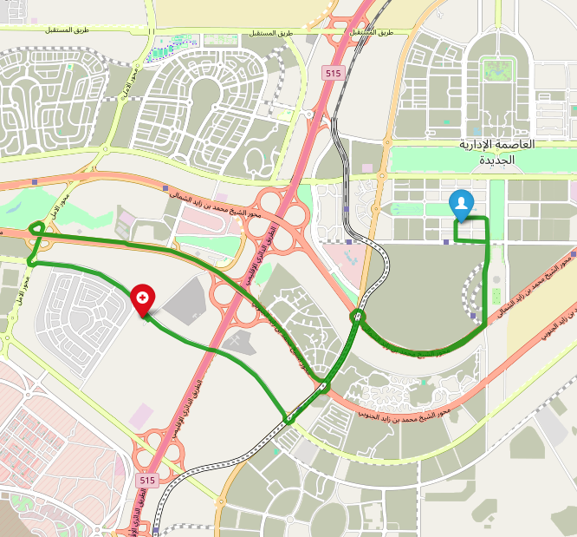
From Hospital to Patient GR
Total Distance=29.28 KM

Slide 17
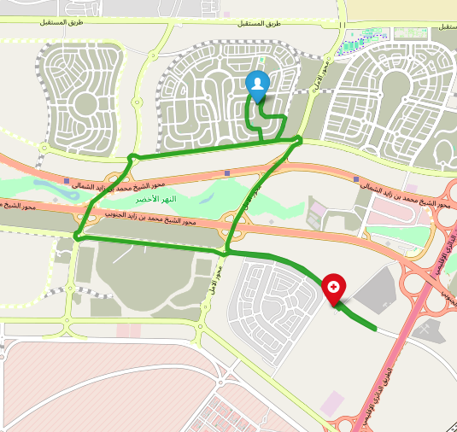
From Hospital to Patient R2
Total Distance=21.31 KM

Slide 18
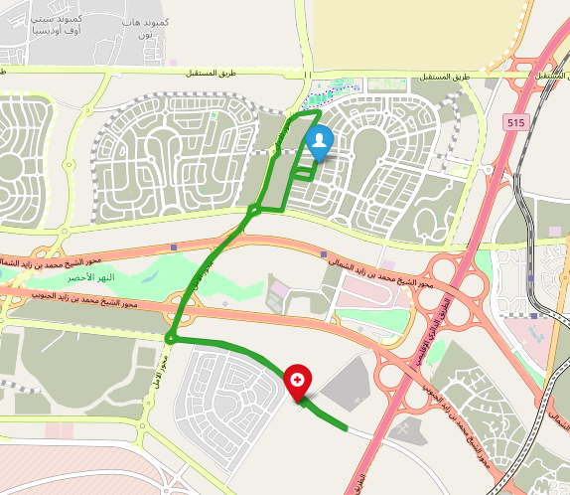
From Hospital to Patient R3_2
Total Distance=18.20 KM

Slide 19
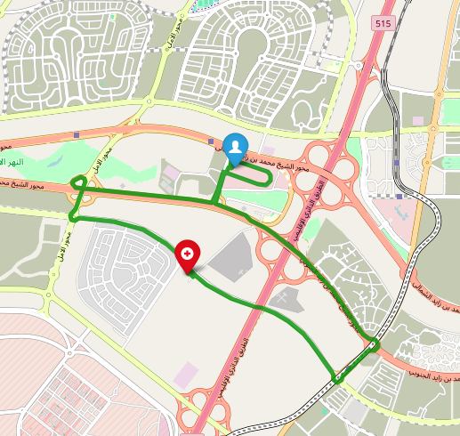
From Hospital to Patient IT
Total Distance=18.94 KM

Slide 20
Upper Bound
Total Distance=110.55 KM

Slide 21
Two Strategies Implemented
Greedy
Brute Force

Slide 22
Brute Force Approach
Tries all possible paths in between the hospital and the patients
Identifies the true optimal solution
Provides a guarantee of the shortest possible distance
Only works for small numbers of patients
Exponential growth in time complexity (factorial)
Computation expensive, infeasible for large cities

Slide 23
Lower Bound
Total Distance=57.31 KM

Slide 24

Upper Bound
Lower Bound
Total Distance=110.55 KM
Total Distance=57.31 KM

Slide 25
Greedy Approach
Begins from the hospital and always chooses the next nearest patient
Repeats until max patients served per trip, returning to the hospital
Fast execution time (milliseconds)
Easy implementation
Does not guarantee a global optimum
Performance decreases when patients spread out in location

Slide 26
Challenges In Classical Approach
Scalability issue
Computation Time
Greedy Trade-Off
Dynamic Traffic Conditions

Slide 27
03
Quantum Approach
A Practical Demonstration with the Quantum Approximate Optimization Algorithm

Slide 28
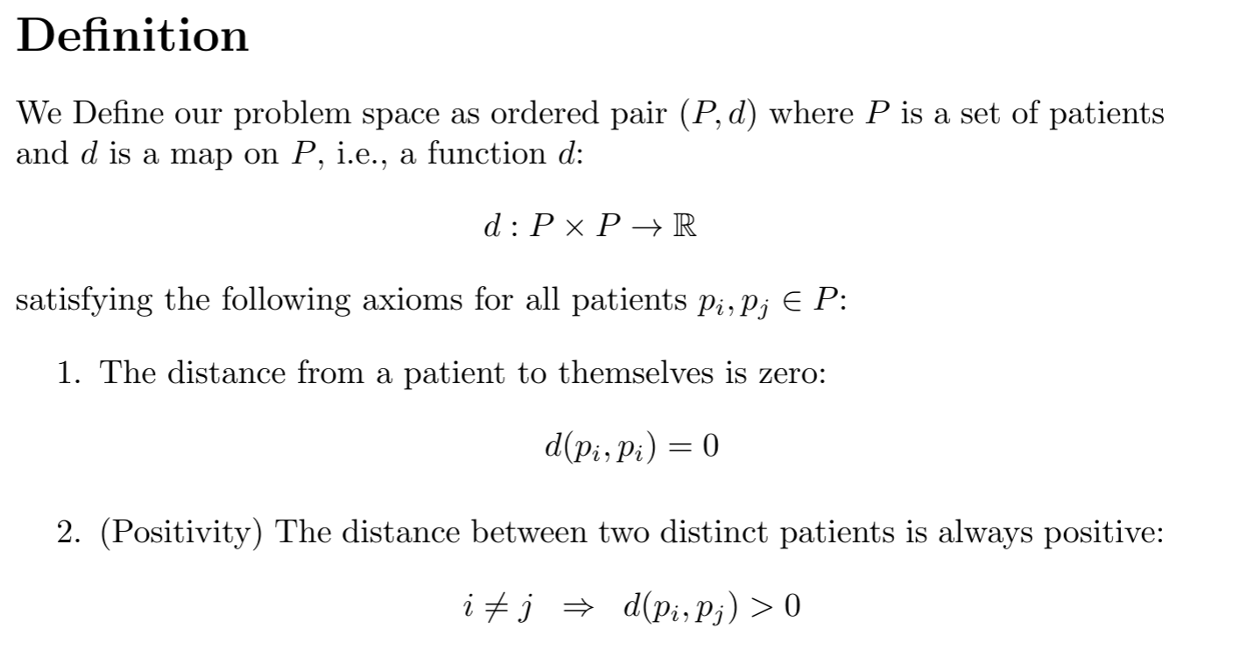

Slide 29

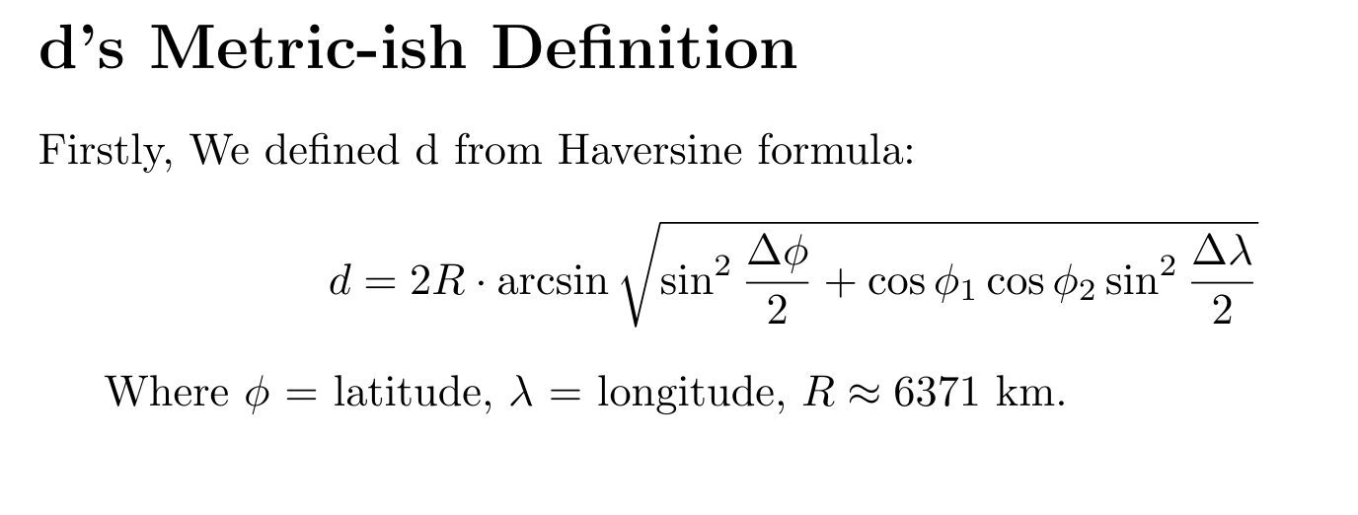

Slide 30
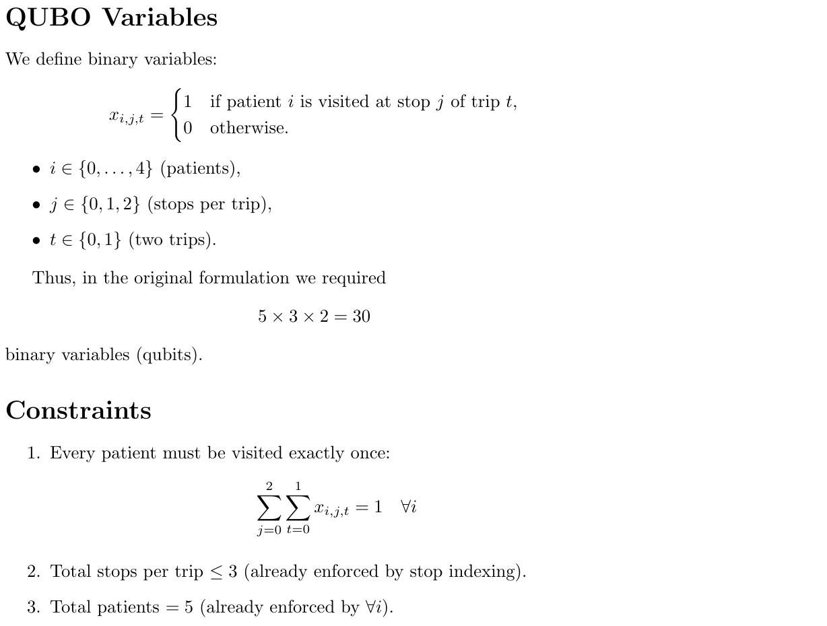

Slide 31
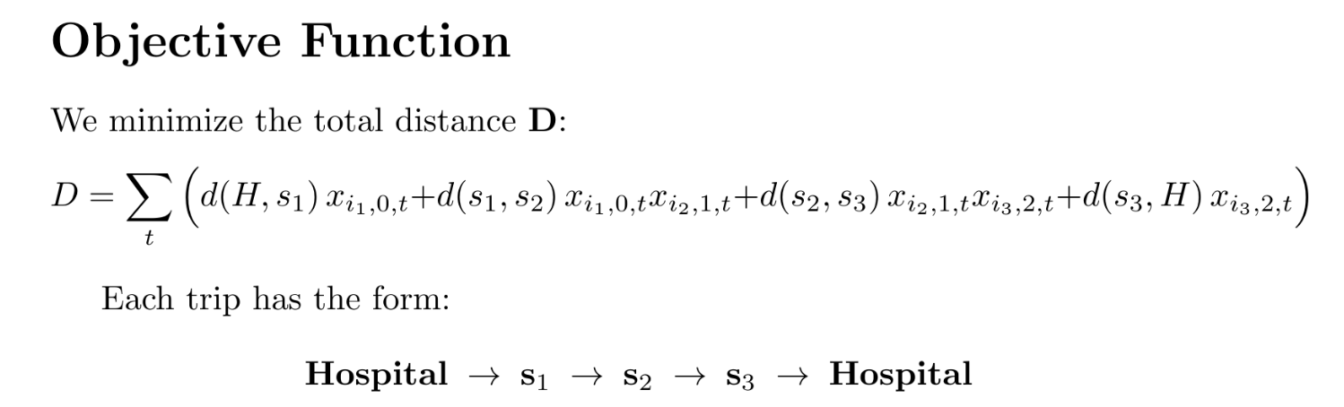

Slide 32
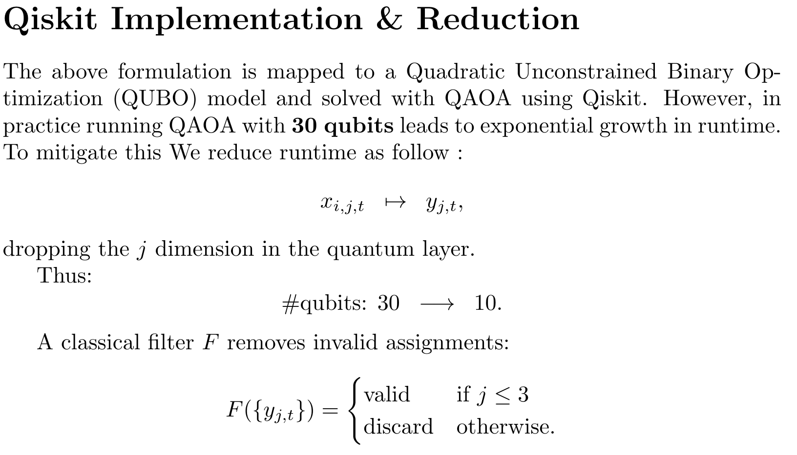

Slide 33
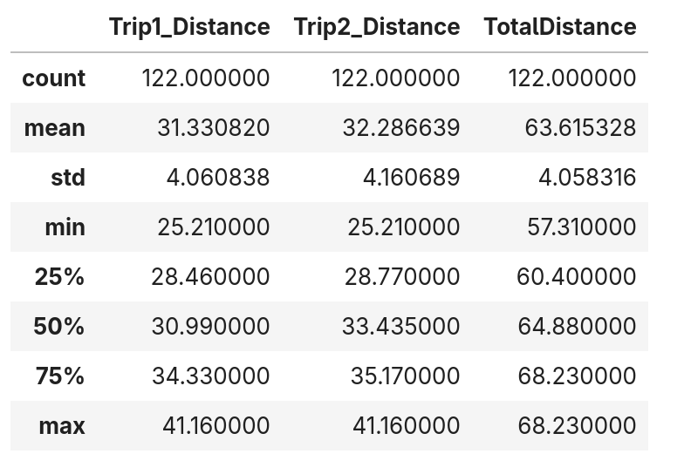

Slide 34
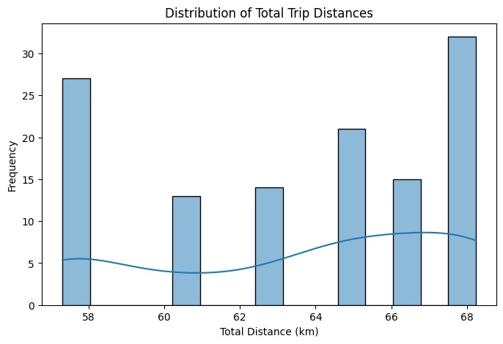

Slide 35
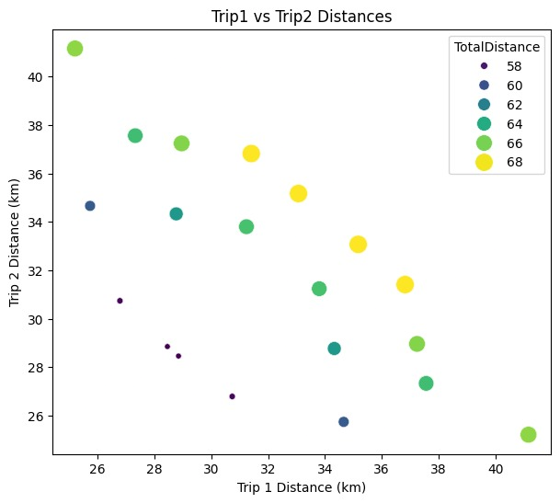

Slide 36
04
Classical
vs.Quantum
By: Youssef Karem

Slide 37
The Classical Solution
Approach: Uses an optimized Brute force Algorithm.
Nature: It is a deterministic approach that builds the solution incrementally, always making the locally optimal choice.
Process: It follows a fixed set of steps to arrive at a single, final solution.
Result: It found the optimal solution of 57.31 km.

Slide 38
The Quantum Solution
Approach: Uses a Quantum Approximate Optimization Algorithm (QAOA).
Nature: It is a probabilistic and approximate approach that finds a near-optimal solution by exploring many possibilities at once.
Process: It requires multiple runs to increase the probability of finding the best solution.
Result: The best solution found was the optimal 57.31 km, but the average result was 63.62 km.

Slide 39
Comparison
Certainty vs. Probability: The classical method gives one certain answer, while the quantum method provides a distribution of possible answers.
Problem-Solving: The classical method is simple and effective for this small problem. The quantum method, despite being approximate, was also able to find the exact optimal answer.
Model Building: The classical approach directly uses road network data. The quantum approach requires the problem to be translated into a complex mathematical format (a QUBO) to be solved on a quantum computer.
Notes:
hi

Slide 40
Comparison
The big picture
Scalability: For larger, more complex problems, the number of possible routes grows exponentially, making classical methods computationally impossible to solve in a reasonable time.
Quantum Potential: Quantum algorithms are specifically designed to handle this exponential complexity. They can efficiently search a vast solution space to find high-quality answers, even if they are approximate.
Notes:
hi

Slide 41
Future plans
Apply the quantum model to a much larger number of patients and constraints.
Integrate real-time data for dynamic routing optimization.
Explore more advanced quantum algorithms to improve the consistency and quality of the solutions found.
Notes:
hi

Slide 42
Thanks!
Do you have any questions?

